Slide 1
R
SVM

Slide 2
Support vector machine
SUPPORT VECTOR MACHINE CLASSIFIER IMPLEMENTATION IN R WITH CARET PACKAGE
Eg: Our motive is to predict whether a patient is having heart disease or not.

Slide 3
caret or e1071 package etc.
The principle behind an SVM classifier (Support Vector Machine) algorithm is to build a hyperplane separating data for different classes. This hyperplane building procedure varies and is the main task of an SVM classifier. The main focus while drawing the hyperplane is on maximizing the distance from hyperplane to the nearest data point of either class. These nearest data points are known as Support Vectors.

Slide 4
install.packages(“caret”)
machine learning caret package( Classification And REgression Training )
It holds tools for data splitting, pre-processing, feature selection, tuning and supervised – unsupervised learning algorithms, etc. It is similar to sklearn library in python.

Slide 5
http://dataaspirant.com/2017/01/19/support-vector-machine-classifier-implementation-r-caret-package/
0: Absence of Heart Disease 1: Presence of Heart Disease

Slide 6
library(caret)
heart_df <- read.csv("heart_tidy.csv", sep = ',', header = FALSE)
str(heart_df)

Slide 7
Data slicing , test, Train
# Data slicing , output as a Matrix
set.seed(3033)
intrain <- createDataPartition(y = heart_df$V14, p= 0.7, list = FALSE)
training <- heart_df[intrain,]
testing <- heart_df[-intrain,]

Slide 8
Preprocessing & Training
anyNA(heart_df)
summary(heart_df)

Slide 9
standardize
We can standardize data using caret’s preProcess() method.
Our target variable consists of 2 values 0, 1. It should be a categorical variable. To convert these to categorical variables, we can convert them to factors.

Slide 10
training[["V14"]] = factor(training[["V14"]])
Training the SVM model
Caret package provides train() method for training our data for various algorithms. We just need to pass different parameter values for different algorithms. Before train() method, we will first use trainControl() method. It controls the computational nuances of the train() method.

Slide 11
trctrl <- trainControl(method = "repeatedcv", number = 10, repeats = 3)
set.seed(3233)
svm_Linear <- train(V14 ~., data = training, method = "svmLinear",
trControl=trctrl,
preProcess = c("center", "scale"),
tuneLength = 10)

Slide 12
svm_Linear
Support Vector Machines with Linear Kernel 210 samples 13 predictor 2 classes: '0', '1‘
Accuracy 0.7920635
Kappa 0.581696
It’s a linear model therefore, it just tested at value “C” =1.

Slide 13
test_pred <- predict(svm_Linear, newdata = testing)
test_pred
testing[["V14"]] = factor(testing[["V14"]])
confusionMatrix(test_pred, testing$V14 )

Slide 14
We can also do some customizations for selecting C value(Cost) in Linear classifier. This can be done by inputting values in grid search.
grid <- expand.grid(C = c(0,0.01, 0.05, 0.1, 0.25, 0.5, 0.75, 1, 1.25, 1.5, 1.75, 2,5))
set.seed(3233)
svm_Linear_Grid <- train(V14 ~., data = training, method = "svmLinear",
trControl=trctrl,
preProcess = c("center", "scale"),
tuneGrid = grid,
tuneLength = 10)
svm_Linear_Grid

Slide 15
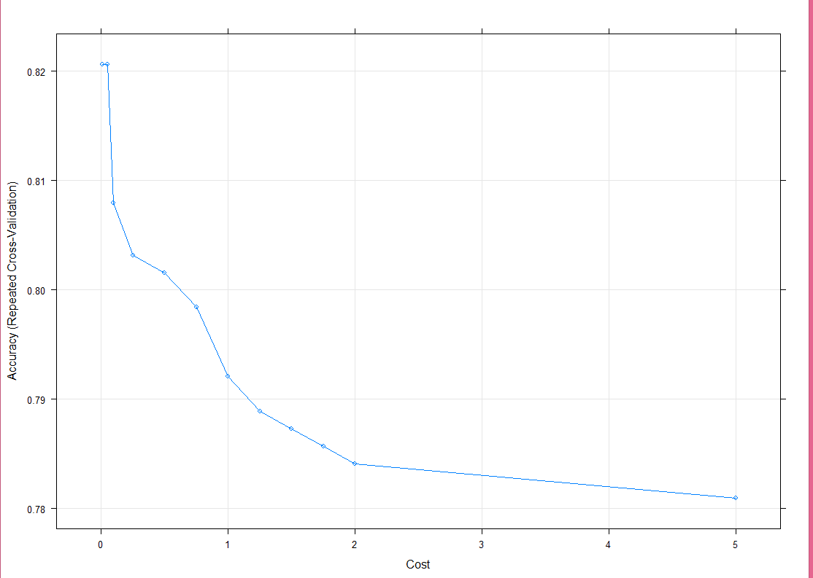
plot(svm_Linear_Grid)

Slide 16
The above plot is showing that our classifier is giving best accuracy on C = 0.05. Let’s try to make predictions using this model for our test set.
test_pred_grid <- predict(svm_Linear_Grid, newdata = testing)
test_pred_grid

Slide 17
confusionMatrix(test_pred_grid, testing$V14 )

Slide 18
SVM Classifier using Non-Linear Kernel
we will try to build a model using Non-Linear Kernel like Radial Basis Function. For using RBF kernel, we just need to change our train() method’s “method” parameter to “svmRadial”. In Radial kernel, it needs to select proper value of Cost “C” parameter and “sigma” parameter.

Slide 19
model were sigma = 0.04744793 and C = 0.25
plot(svm_Radial)
plot(svm_Radial_Grid)

Slide 20
library(e1071)
iris
iris.part = subset(iris) # , Species != 'setosa'
iris.part$Species = factor(iris.part$Species)
iris.part
iris.part = iris.part[, c(1,2,5)]
fit = svm(Species ~ ., data=iris.part, type='C-classification', kernel='linear')
plot(fit, iris.part)

Slide 21
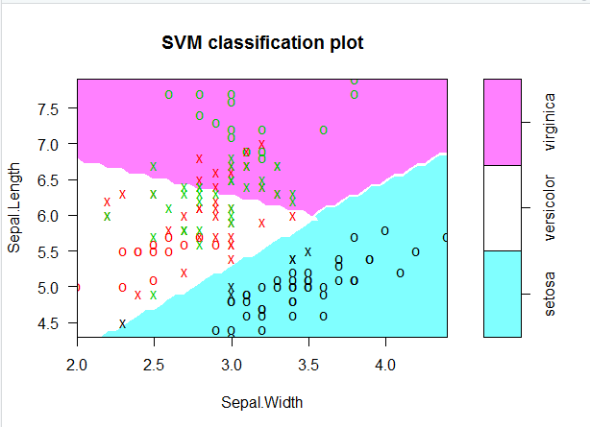

Slide 22
What is Support Vector Machine?
The main idea of support vector machine is to find the optimal hyperplane (line in 2D, plane in 3D and hyperplane in more than 3 dimensions) which maximizes the margin between two classes. In this case, two classes are red and blue balls. In layman's term, it is finding the optimal separating boundary to separate two classes (events and non-events).
Support Vectors are observations that supports hyperplane on either sides. In the image above, filled red and blue boxes and circles are support vectors.

Slide 23
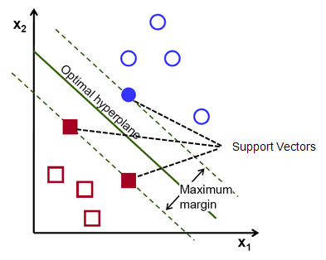

Slide 24
Hyperplane is just a line in 2D and plane in 3D. In higher dimensions (more than 3D), it's called hyperplane. SVM help us to find a hyperplane (or separating boundary) that can separate two classes (red and blue dots).

Slide 25
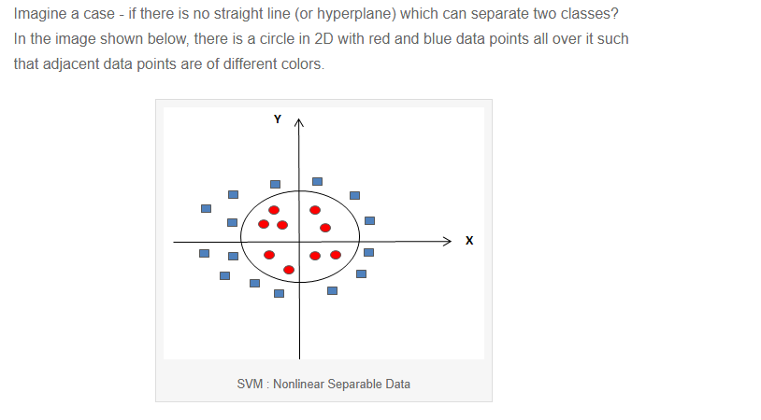
How to treat Non-linear Separable Data?

Slide 26
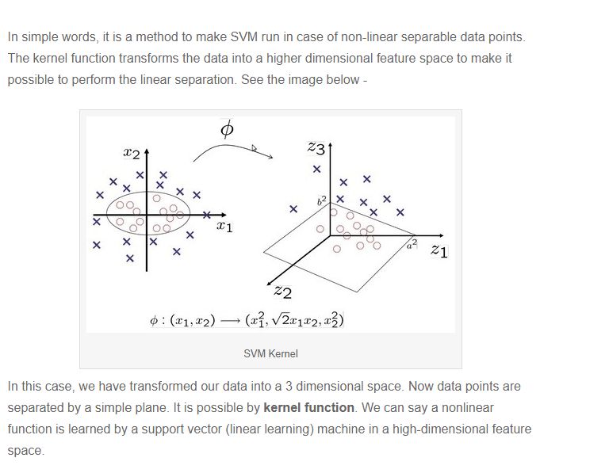
What is Kernel?

Slide 27
Different Kernels
1. linear: u'*v
2. polynomial: (gamma*u'*v + coef0)^degree
3. radial basis (RBF) : exp(-gamma*|u-v|^2)
4. sigmoid : tanh(gamma*u'*v + coef0)
RBF is generally the most popular one.

